Slide 1
Memory Mapping
Sarah Diesburg
COP5641

Slide 2
Memory Mapping
Translation of address issued by some device (e.g., CPU or I/O device) to address sent out on memory bus (physical address)
Mapping is performed by memory management units

Slide 3
Memory Mapping
CPU(s) and I/O devices may have different (or no) memory management units
  No MMU means direct (trivial) mapping
Memory mapping is implemented by the MMU(s) using page (translation) tables stored in memory
The OS is responsible for defining the mappings, by managing the page tables

Slide 4
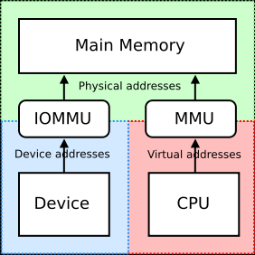
Memory Mapping
AGP and PCI Express graphics cards us a Graphics Remapping Table (GART), which is one example of an IOMMU. See Wiki article on IOMMU for more detail on memory mapping with I/O devices. http://en.wikipedia.org/wiki/IOMMU

Slide 5
Memory Mapping
Typically divide the virtual address space into pages
  Usually power of 2
The offset (bottom n bits) of the address are left unchanged
The upper address bits are the virtual page number

Slide 6
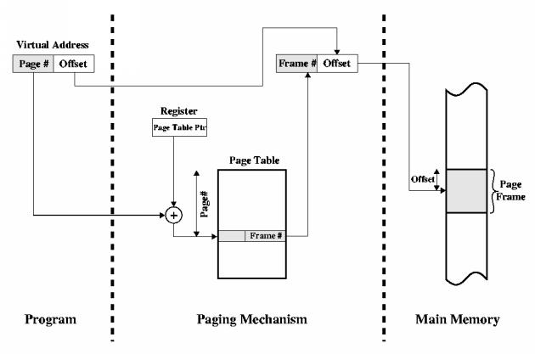
Address Mapping Function (Review)

Slide 7
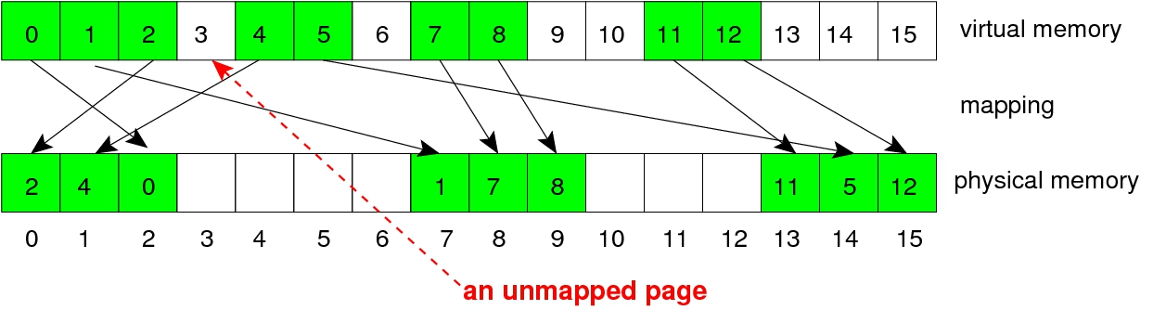
Unmapped Pages
The mapping is sparse. Some pages are unmapped.
Notes:
Why are some pages unmapped?
Processes get a large amount of virtual address space each, but in practice they only use a tiny amount. Constructs like the stack and heap are places far away from each other.

Slide 8
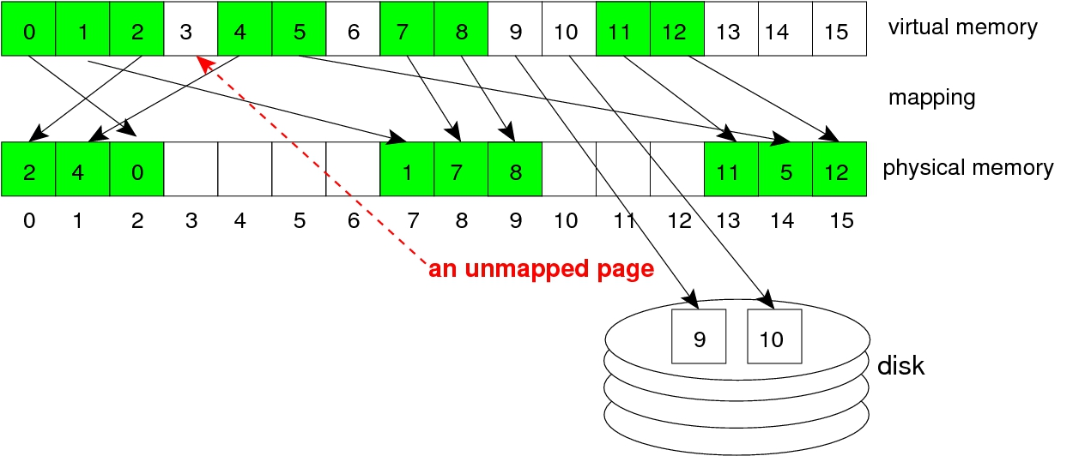
Unmapped Pages
Pages may be mapped to locations on devices and others to both.

Slide 9
MMU Function
MMU translates virtual page numbers to physical page numbers via Translation Lookaside Buffer (TLB)
If TLB lacks translation, slower mechanism is used with page tables
The physical page number is combined with the page offset to give the complete physical address

Slide 10
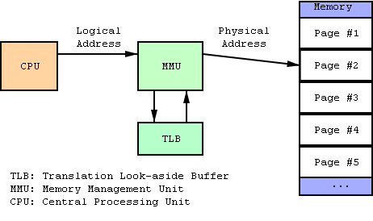
MMU Function

Slide 11
MMU Function
Computes address translation
Uses special associative cache (TLB) to speed up translation
Falls back on full page translation tables, in memory, if TLB misses
Falls back to OS if page translation table misses
  Such a reference to an unmapped address causes a page fault

Slide 12
MMU Function
If page fault caused by a CPU (MMU)
  Enters the OS through a trap handler
If page fault caused by an I/O device (IOMMU)
  Enters the OS through an interrupt handler
What reasons could cause a page fault?
Notes:
Page fault could occur when 1) need to fetch pages into main memory from swap or device, 2) process segfault

Slide 13
Possible Handler Actions
Map the page to a valid physical memory location
  May require creating a page table entry
  May require bringing data in to memory from a device
Treat the event as an erro (e.g., SIG_SEGV)
Pass the exception on to a device-specific handler
  The device's fault method

Slide 14
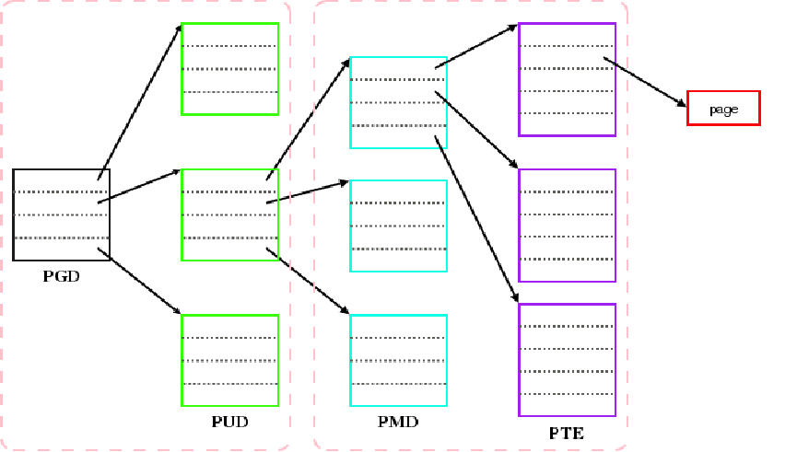
Linux Page Tables 4-levels
Notes:
http://lwn.net/Articles/117749/
PGD = page global directory, PUD = page upper directory, PMD = page middle directory, PTE = page table entry
Q: How does having multiple levels save memory?
A: A single array large enough to hold the page table entries for a single process would be huge, even though many would be unmapped. Tree structure allows tables to be broken up into individual pages, while subtrees corresponding to unused parts of the address space can be absent.

Slide 15
Linux Page Tables
Logically, Linux now has four levels of page tables:
  PGD - top level, array of pgd_t items
  PUD - array of pud_t items
  PMD - array of pmd_t items
  PTE - bottom level, array of pte_t items
On architectures that do not require all four levels, inner levels may be collapsed
Page table lookups (and address translation) are done by the hardware (MMU) so long as the page is mapped and resident
Kernel is responsible for setting the tables up and handling page faults
Table are located in struct mm object for each process

Slide 16
Kernel Memory Mapping
Each OS process has its own memory mapping
Part of each virtual address space is reserved for the kernel
This is the same range for every process
So, when a process traps into the kernel, there is no change of page mappings
This is called "kernel memory"
The mapping of the rest of the virtual address range varies from one process to another

Slide 17
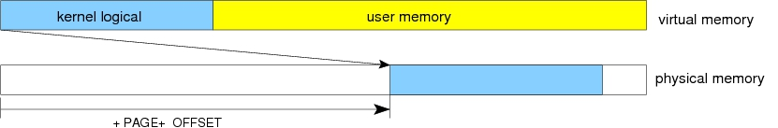
Kernel Logical Addresses
Most of the kernel memory is mapped linearly onto physical addresses
Virtual addresses in this range are called kernel logical addresses
Examples of PAGE_OFFSET values:
  64-bit X86: 0xffffffff80000000
  ARM & 32-bit X86: CONFIG_PAGE_OFFSET
  default on most architectures = 0xc0000000

Slide 18
Kernel Logical Addresses
In user mode, the process may only access addresses less than 0xc0000000
  Any access to an address higher than this causes a fault
However, when user-mode process begins executing in the kernel (e.g. system call)
  Protection bit in CPU changed to supervisor mode
  Process can access addresses above 0xc0000000

Slide 19
Kernel Logical Addresses
Mapped using page table by MMU, like user virtual addresses
But mapped linearly 1:1 to contiguous physical addresses
__pa(x) adds PAGE_OFFSET to get physical address associated with virtual address
__va(x) subtracts PAGE_OFFSET to get virtual address associated with physical address
All memory allocated by kmalloc() with GFP_KERNEL fall into this category

Slide 20
Page Size Symbolic Constants
PAGE_SIZE
  value varies across architectures and kernel configurations
  code should never use a hard-coded integer literal like 4096
PAGE_SHIFT
  the number of bits to right shift to convert virtual address to page number
  and physical address to page frame number
Notes:
What are the advantages of a larger page size? Disadvantages?

Slide 21
struct page
Describes a page of physical memory.
One exists for each physical memory page
Pointer to struct page can be used to refer to a physical page
members:
  atomic_t count = number of references to this page
  void * virtual = virtual address of the page, if it is mapped (in the kernel memory space) / otherwise NULL
  flags = bits describing status of page
    PG_locked - (temporarily) locked into real memory (can't be swapped out)
    PG_reserved - memory management system "cannot work on the page at all"
    ... and others

Slide 22
struct page pointers ↔ virtual addresses
struct page *virt_to_page(void *kaddr);
  Given a kernel logical address, returns associated struct page pointer
struct page *pfn_to_page(int pfn);
  Given a page frame number, returns the associated struct page pointer
void *page_address(struct page *page);
  Returns the kernel virtual address, if exists.
Notes:
Most of the time you are dealing with virtual address, so you would use virt_to_page();

Slide 23
kmap() and kunmap()
kmap is like page_address(), but creates a "special" mapping into kernel virtual memory if the physical page is in high memory
  there are a limited number of such mappings possible at one time
  may sleep if no mapping is currently available
  not needed for 64-bit model
kunmap() - undoes mapping created by kmap()
  Reference-count semantics

Slide 24
Some Page Table Operations
pgd_val() - fetches the unsigned value of a PGD entry
pmd_val() - fetches the unsigned value of a PMD entry
pte_val() - fetches the unsigned value of PTE
mm_struct - per-process structure, containing page tables and other MM info

Slide 25
Some Page Table Operations
pgd_offset() - pointer to the PGD entry of an address, given a pointer to the specified mm_struct
pmd_offset() - pointer to the PMD entry of an address, given a pointer to the specified PGD entry
pte_page() - pointer to the struct page() entry corresponding to a PTE
pte_present() - whether PTE describes a page that is currently resident

Slide 26
Some Page Table Operations
Device drivers should not need to use these functions because of the generic memory mapping services described next

Slide 27
Virtual Memory Areas
A range of contiguous VM is represented by an object of type struct vm_area_struct.
Used by kernel to keep track of memory mappings of processes
Each is a contract to handle the VMem→PMem mapping for a given range of addresses
Some kinds of areas:
  Stack, memory mapping segment, heap, BSS, data, text

Slide 28
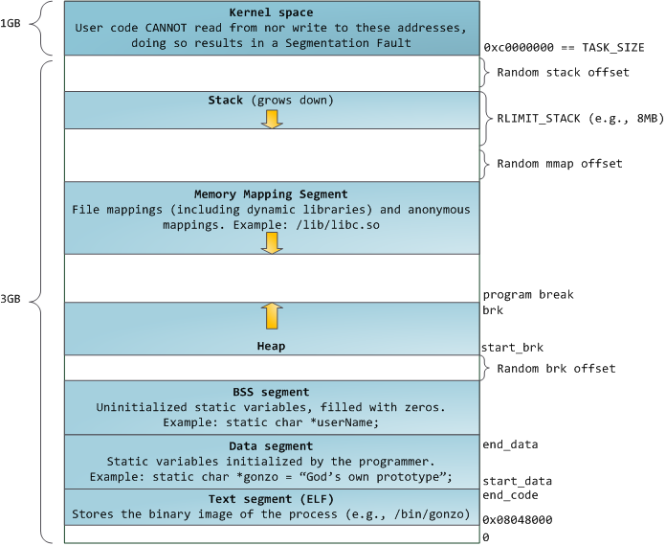
Notes:
http://duartes.org/gustavo/blog/post/anatomy-of-a-program-in-memory

Slide 29
Virtual Memory Regions
Stack segment
  Local variable and function parameters
  Will dynamically grow to a certain limit
  Each thread in a process gets its own stack
Memory mapping segment
  Allocated through mmap()
  Maps contents of file directly to memory
    Fast way to do I/O
  Anonymous memory mapping does not correspond to any files
    Malloc() may use this type of memory if requested area large enough
Notes:
http://duartes.org/gustavo/blog/post/anatomy-of-a-program-in-memory

Slide 30
Virtual Memory Segments
Heap
  Meant for data that must outlive the function doing the allocation
  If size under MMAP_THRESHOLD bytes, malloc() and friends allocate memory here
BSS
  "block started by symbol“
  Stores uninitialized static variables
  Anonymous (not file-backed)
Notes:
http://duartes.org/gustavo/blog/post/anatomy-of-a-program-in-memory

Slide 31
Virtual Memory Segments
Data
  Stores static variables initialized in source code
  Not anonymous
Text
  Read-only
  Stores code
  Maps binary file in memory
Notes:
http://duartes.org/gustavo/blog/post/anatomy-of-a-program-in-memory

Slide 32
Process Memory Map
struct mm_struct - contains list of process' VMAs, page tables, etc.
accessible via current-> mm
The threads of a process share one struct mm_struct object

Slide 33
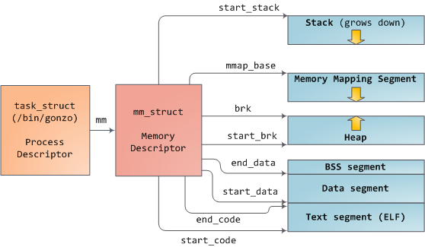
Virtual Memory Regions
Notes:
http://duartes.org/gustavo/blog/post/how-the-kernel-manages-your-memory

Slide 34
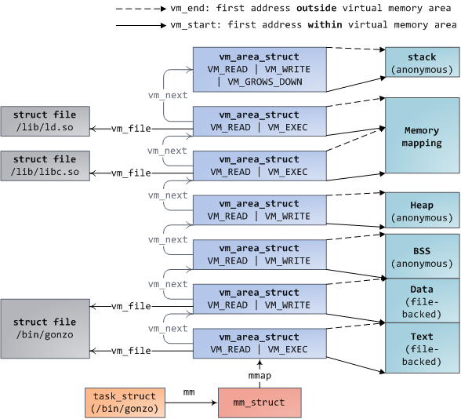
Virtual Memory Area Mapping Descriptors
Notes:
http://duartes.org/gustavo/blog/post/how-the-kernel-manages-your-memory

Slide 35
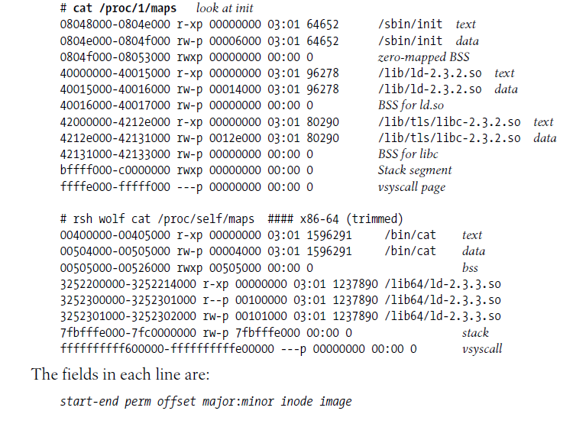

Slide 36
struct vm_area_struct
Represents how a region of virtual memory is mapped
Members include:
  vm_start, vm_end - limits of VMA in virtual address space
  vm_page_prot - permissions (p = private, s = shared)
  vm_pgoff - of memory area in the file (if any) mapped

Slide 37
struct vm_area_struct
  vm_file - the struct file (if any) mapped
  provides (indirect) access to:
    major, minor - device of the file
    inode - inode of the file
    image - name of the file
  vm_flags - describe the area, e.g.,
    VM_IO - memory-mapped I/O region will not be included in core dump
    VM_RESERVED - cannot be swapped
  vm_ops - dispatching vector of functions/methods on this object
  vm_private_data - may be used by the driver

Slide 38
vm_operations_struct.vm_ops
void *open (struct vm_area_struct *area);
  allows initialization, adjusting reference counts, etc.;
  invoked only for additional references, after mmap(), like fork()
void *close (struct vm_area_struct *area);
  allows cleanup when area is destroyed;
  each process opens and closes exactly once
int fault (struct vm_area_struct *vma, struct vm_fault *vmf);
  general page fault handler;

Slide 39
Uses of Memory Mapping by Device Drivers
A device driver is likely to use memory mapping for two main purposes:
  To provide user-level access to device memory and/or control registers
    For example, so an Xserver process can access the graphics controller directly
  To share access between user and device/kernel I/O buffers, to avoid copying between DMA/kernel buffers and userspace

Slide 40
The mmap() Interfaces
User-level API function:
  void *mmap (caddr_t start, size_t len, int prot, int flags, int fd, off_t offset);
Driver-level file operation:
  int (*mmap) (struct file *filp, struct vm_area_struct *vma);

Slide 41
Implementing the mmap() Method in a Driver
Build suitable page tables for the address range two ways:
  Right away, using remap_pfn_range or vm_insert_page
  Later (on demand), using the fault() VMA method
Replace vma->vm_ops with a new set of operations, if necessary

Slide 42
The remap_pfn_range() Kernel Function
Use to remap to system RAM
  int remap_pfn_range (struct vm_area_struct *vma, unsigned long addr, unsigned long pfn, unsigned long size, pgprot_t prot);
Use to remap to I/O memory
  int io_remap_pfn_range(struct vm_area_struct *vma, unsigned long addr ,unsigned long phys_addr, unsigned long size, pgprot_t prot);

Slide 43
The remap_pfn_range() Kernel Function
vma = virtual memory are to which the page range is being mapped
addr = target user virtual address to start at
pfn = target page frame number of physical address to which mapped
  normally vma->vm_pgoff>>PAGE_SHIFT
  mapping targets range (pfn<<PAGE_SHIFT) .. (pfn<<PAGE_SHIFT)+size
prot = protection
  normally the same value as found in vma->vm_page_prot
  may need to modify value to disable caching if this is I/O memory

Slide 44
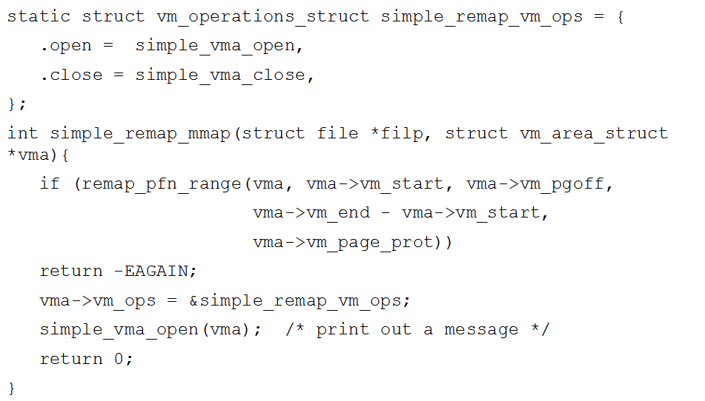
The remap_pfn_range() Kernel Function

Slide 45
Using fault()
LDD3 discusses a nopage() function that is no longer in the kernel
  Race conditions
Replaced by fault()
http://lwn.net/Articles/242625/

Slide 46
Using fault()
struct page (*fault)(struct vm_area_struct *vma, struct vm_fault *vmf);
vmf - is a struct vm_fault, which includes:
  flags
    FAULT_FLAG_WRITE indicates the fault was a write access
    FAULT_FLAG_NONLINEAR indicates the fault was via a nonlinear mapping
  pgoff - logical page offset, based on vma
  virtual_address - faulting virtual address
  page - set by fault handler to point to a valid page descriptor; ignored if VM_FAULT_NOPAGE or VM_FAULT_ERROR is set

Slide 47
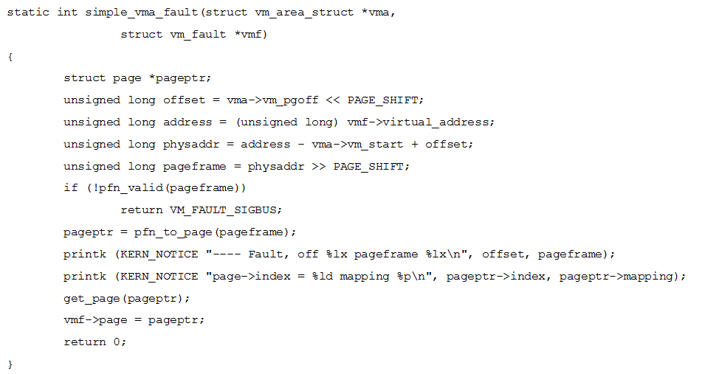
Using fault()

Slide 48
A Slightly More Complete Example
See ldd3/sculld/mmap.c
http://www.cs.fsu.edu/~baker/devices/notes/sculld/mmap.c

Slide 49
Remapping I/O Memory
remap_pfn_to_page() cannot be used to map addresses returned by ioremap() to user space
instead, use io_remap_pfn_range() directly to remap the I/O areas into user space

